Slide 1
My Journey and Personal Growth Name: Phindile Lisa Ngozi Student Number: 230640893 Date: 23 May 2025

Slide 2
Agenda
About Me
My Skills
Current Assignments
Challenges I Faced
How I have grown
Reflections

Slide 3
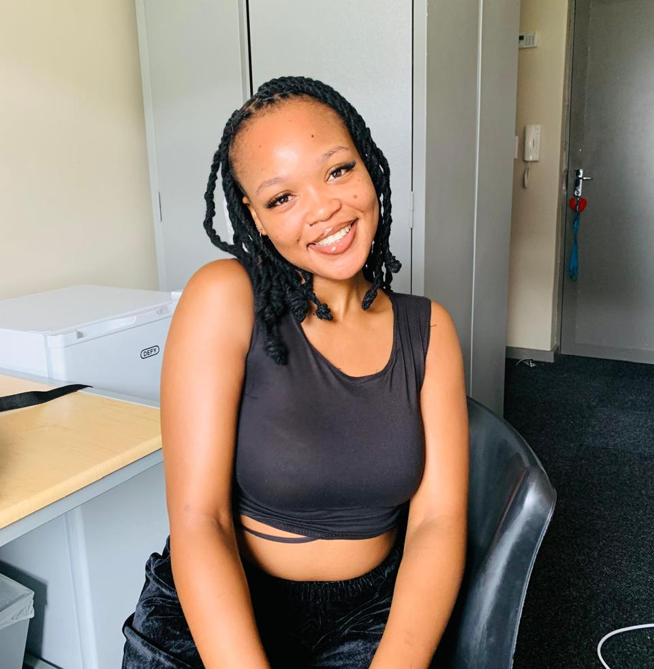
About Me I am Phindile Lisa Ngozi, a third-year student at the Cape Peninsula University of Technology, majoring in ICT: Applications Development. I am passionate about learning, problem-solving, and embracing challenges. I aspire to grow in fields such as cybersecurity, software development, and data analytics. Technology is not just a field for me, it is a passion and a means to make a meaningful impact.

Slide 4

My Skills
Technical Skills:
SQL & Database Management (SQLite Studio)
Java
HTML/CSS, JavaScript
UI/UX Design with Figma
Soft Skills:
Communication & teamwork
Adaptability and growth mindset

Slide 5
Current Assignments
Assignment 1 MBD Management System
Group Project for ITS362S
Goal: Design a database system to track births, deaths, and marriages
Contribution: Building the ERD with full attribution
Skills Gained: Understanding of relational databases, Collaboration.

Slide 6
Cont.
Assignment 2
CPUT Bus Transit System
Role: UI/UX Designer
Focus: Shuttle tracking app with real-time location updates, notifications, and seat booking
Tools Used: Figma,
Gained: Designing intuitive and user-friendly interfaces.
Assignment 3
CPUT Cafeteria Menus and More Project
Type: Individual (Project Management 3)
Description: Web-based system for digital menu access and pre-ordering meals
Tasks Completed: Project Charter, Scope Statement, Cost-Benefit Analysis Skills
Gained: Strategic planning and scope management.

Slide 7
Challenge Faced
Time Management: Previously had issues with meeting deadlines and multitasking.
Public Speaking: Lacked confidence in speaking up in class and team meetings.
Confidence in Technical Tools: I used to be intimidated by tools like React.js and Firebase.

Slide 8

How I Have Grown
Improved Time Management:
Using planners and computer-based tools like Trello helped keep me on track.
Prioritizing tasks and setting deadlines for myself was a discipline lesson.
Technical Competence:
Practice and consistency helped me feel more confident with more complex tools.
Following instructions and asking for help accelerated learning.
Personal Development:
I now take initiative in group projects and help organize tasks.
Requesting feedback has made me more open to constructive criticism.
I feel more confident now to talk during presentations and team meetings.

Slide 9
Reflection
Looking back on my educational experience, I can see how far I have come professionally and as an individual. Those obstacles I once struggled with, including public speaking and time management, are now my assets. Each project pushed me to become better at new abilities, from learning technical abilities like SQL to feeling more assured in leading and collaborating with others. My interest in technology has grown stronger, and I am better equipped than ever before to pursue future endeavors within the technology sector. I am content with how far I have come and look forward to what is next.

Slide 10
THANK YOU

